Slide 1
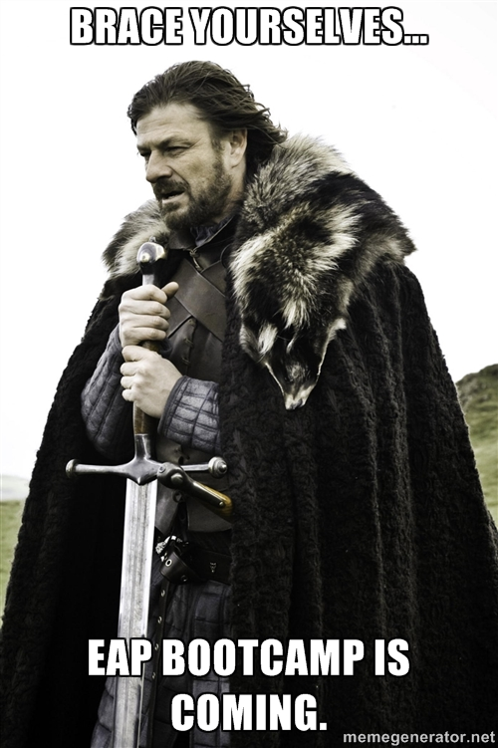
EAP BOOTCAMP

Slide 2
AGENDA: 2/19 & 2/20
Bellwork- Grammar (Wednesday) or TAPS worksheet (Thursday)
Writing Portfolio Explanation
Breaking Down the prompt- CV/SN
Author’s Argument Chart
Revisiting the EPT 6-point rubric
Scoring student essays from Thoreau Timed write
EAP Bootcamp Prompts handout
HOMEWORK: Coffman Timed Write, prompt 2 (give
yourself only 45 minutes to write the essay!)

Slide 3
Writing Portfolio
Your grade during this unit will be comprised of a total 400 points. These points will be earned mainly from the timed writes and revisions that we complete both in class and for homework.
You will be responsible for keeping track of all of your work during this unit and turning it in at the end in your completed portfolio.
We will be meeting with you at least once during this unit (one-on-one) to zone in on your specific needs as a writer.

Slide 4
Breaking Down the Prompt
It is important to know how to Break down the Prompt so that you know exactly HOW to respond to the author’s passage.
“Circle the Verb, Square the Noun”
Circle all of the verbs in the prompt
Square all of the nouns
Pair the verbs with the subsequent nouns
Write them down (in a list)

Slide 5
Breaking Down the Prompt
Explain the passage above by Thoreau and discuss the extent to which you agree or disagree with him. Support your position by referring to the passage and providing reasons and examples from your own experience, observations, or reading.
Explain → thoreau’s passage
Discuss → The extent of your stance
Agree or Disagree → with Thoreau
Support → Your Stance
Refer → to the passage
Provide → reasons & examples (from experience, observation, reading)

Slide 6
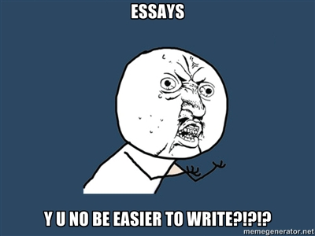

Slide 7
Working with the Author’s Argument
90% of the time, when a student fails to pass the essay portion of the EAP, it is because they failed to properly identify the author’s argument.
We’re going to work on isolating the author’s argument within the context paragraph of various essay prompts. Use the chart that was handed out to you to write down the information as we go along.

Slide 8
Author’s Argument Chart
TOPIC | AUTHOR’S ARGUMENT Their Words | AUTHOR’S ARGUMENT Your Words | AUTHOR’S ARGUMENT Question

Slide 9
Prompt One
A well-known educator and politician wrote, "As an immigrant to this nation, I am keenly aware of the things that bind us as Americans and unite us as a single people. Foremost among these unifying forces is the common language we share. While it is certainly true that our love of freedom and devotion to democratic principles help to unite and give us a mutual purpose, it is English, our common language, that enables us to discuss our views and allows us to maintain a well-informed electorate of democratic government."

Slide 10
Author’s Argument Chart
A well-known educator and politician wrote, "As an immigrant to this nation, I am keenly aware of the things that bind us as Americans and unite us as a single people. Foremost among these unifying forces is the common language we share. While it is certainly true that our love of freedom and devotion to democratic principles help to unite and give us a mutual purpose, it is English, our common language, that enables us to discuss our views and allows us to maintain a well-informed electorate of democratic government."
TOPIC | AUTHOR’S ARGUMENT Their Words | AUTHOR’S ARGUMENT Your Words | AUTHOR’S ARGUMENT Question
English as a common language | “…it is English, our common language, that enables us to discuss our views and allows us to maintain a well-informed electorate of democratic government." | The common language of English lets us share our opinions and enables us to keep up an educated group of voters that choose their government. | Is the common language we share the primary unifying factor in our democratic nation?

Slide 11
Prompt Two
One writer asserts that prejudice "isn't about your personal beliefs that are contrary to others'; it's about your actions toward them and your lack of respect for their views. There are many explanations for intolerant attitudes, some dating back to childhood. It is likely that intolerant folks grew up imitating intolerant parents and the cycle of prejudice has simply continued for generations. Perhaps intolerant people are so set in their ways that they find it easier to ignore anything that might not conform to their limited view of life."

Slide 12
Author’s Argument Chart
One writer asserts that prejudice "isn't about your personal beliefs that are contrary to others'; it's about your actions toward them and your lack of respect for their views. There are many explanations for intolerant attitudes, some dating back to childhood. It is likely that intolerant folks grew up imitating intolerant parents and the cycle of prejudice has simply continued for generations. Perhaps intolerant people are so set in their ways that they find it easier to ignore anything that might not conform to their limited view of life."
TOPIC | AUTHOR’S ARGUMENT Their Words | AUTHOR’S ARGUMENT Your Words | AUTHOR’S ARGUMENT Question
Intolerance | “…prejudice…[is] about your actions toward [those with differing opinions] and your lack of respect for their views.” | Being prejudice consists of treating those with differing views AND their opinions disrespectfully. | What does prejudice consist of?

Slide 13
Practice Time!
How well did you grasp this activity?
It’s time to find out!
You will complete THIS EXACT activity on your own for each of the remaining four prompts. Do your own work and do NOT talk or discuss with your neighbors.
DO NOT DELVE into whether you agree or disagree with ANY OF THESE topics…we’re not there yet.

Slide 14
Prompt Three
According to one writer, "Studying science is excellent training for the mind. Science can teach that some things are quite definitely wrong; that knowledge is a much better guide than ignorance, and it can teach humility in posing endless questions to which we have no good answers."

Slide 15
Prompt Four
"We inhabit a self-congratulatory society in which we constantly reassure each other how well we're doing. You can't tell anyone anymore that they're no good - or less good - than their peers. One way to view this rampaging flattery is as constructive hypocrisy: hypocrisy, because we know it's false; constructive, because the pretense does us good. Not everyone can win every game, so we devise consolation prizes that make the losers feel better without hurting feelings and puff up our self-esteem; but it's harmful when the truth ultimately intrudes, as it usually does."

Slide 16
Prompt Five
Anne Morrow Lindbergh spent a month alone by the ocean, and wrote of her experience in Gift from the Sea: ". . . more of us in America than anywhere else in the world have the luxury of choice between simplicity and complication in life. And for the most part we, who could choose simplicity, choose complication. War, prison, survival periods, enforce a form of simplicity on man. The monk and the nun choose it of their own free will. But if one accidentally finds it, as I have for a few days, one finds also the serenity it brings.“

Slide 17
Prompt Six
A great statesman once said, "The test of progress is not whether we add more to the abundance of those who have much, it is whether we provide enough for those who have too little."

Slide 18
TRADE & GRADE
Collect all Author’s Argument Charts at your table and trade them with another table group.
1 point per answer in each box, for a total of 16 points.
Anyone caught “helping” their friends will receive an automatic zero!

Slide 19
Calibrating the EPT RUBRIC
It’s important that we ALL understand what gives an essay its particular score and are on the same page about it.
Familiarizing yourself closely with the rubric will give you the knowledge you need to write a better essay and receive a passing score.
LETS REVIEW THE RUBRIC AS A CLASS…

Slide 20
Calibrating to the EPT RUBRIC
Please set-up a chart on a separate sheet of paper like the one below:
ESSAY | My score | Reasoning | Actual Score

Slide 21
EAP PROMPTS HANDOUT
This handout contains all of the main prompts you will use to write your essays. Please do not lose this as it will be the only handout you receive for these prompts.
Make sure you bring ALL of the EAP handouts/worksheets with you to EVERY class!!!
We will use ALL of them…
ALL of the time!

