Slide 1
Bellwork!

Slide 2
Pick out a line from the song.
Why did you pick it and what does it mean to you?
Notes:
Given the option to connect the content to Lord of the Flies. I said right off that it does connect, but also they may have wanted to take it a different direction, talking about the comment the artist is making on the world, people, or relating it to their own life.

Slide 3
We're building towers, with no foundation. Just stacking stone on stone Whatever it takes Mix our mortar with bones True progress means, matching the world to The vision in our heads. We always change, The vision instead. We set sail with no fixed star in sight. We drive by braille in candle light
We talk too much We talk in circles Till we're all spinning around, Reaching for rings, On this marry-go-round The scenery spins We call it progress I've seen this all before When all said is done, Wake up on the floor We set sail with no fixed star in sight We drive by braille in candle light
“Circles” by Thrice

Slide 4
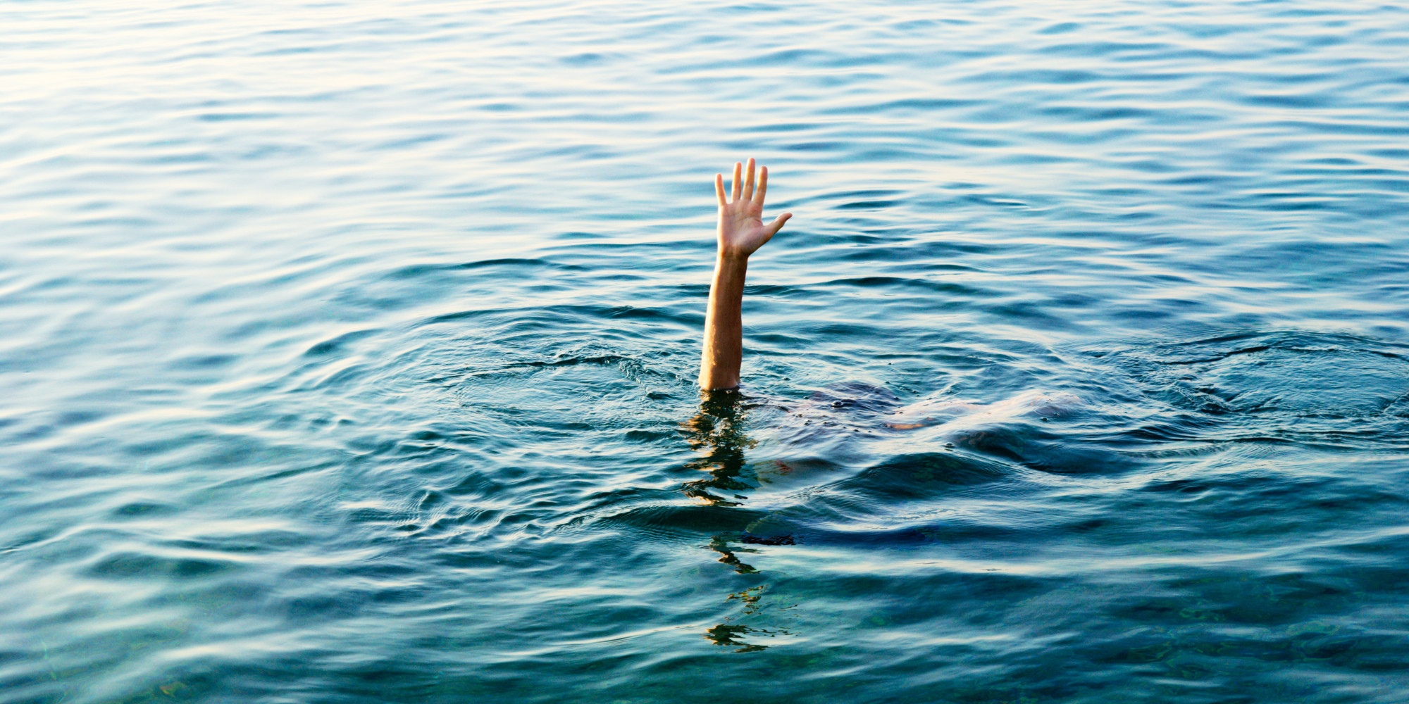

Slide 5
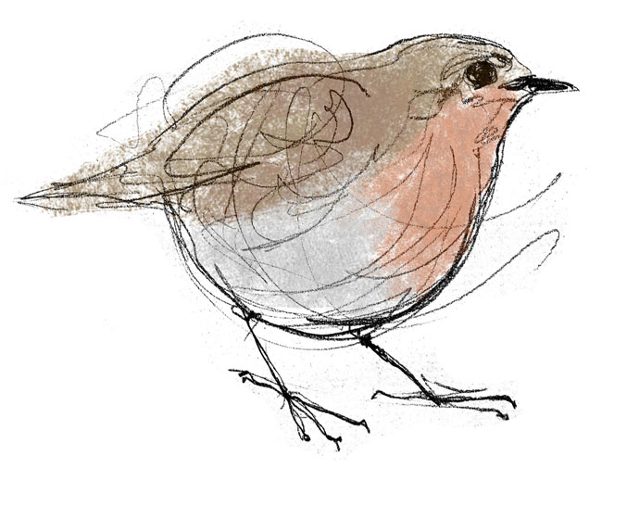
Round Robin
Each person is given a turn to say something.
Each person in the group will listen actively and allow the person to speak. No comments are to be made during the time the speaker speaks.
Everyone must treat your group members with respect.

Slide 6
Presentations
Use a loud voice
Pace yourself
Audience do not talk during presentation
Take Cornell notes

Slide 7
Evaluate
Rate your group members 1 to 5 on how each person contributed to the group
2)Write a comment about the rating you gave.

