Slide 1
The Politics of Food

Slide 2
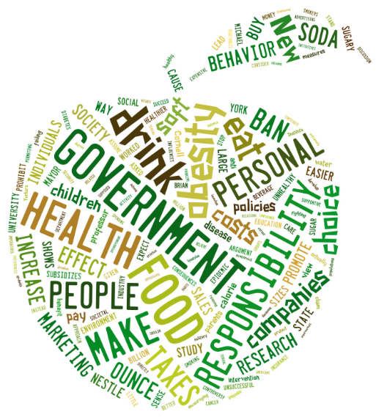
Journal
What can you infer from the words in this image?
What is your relationship with food? Would you say your relationship with food is “healthy” or “unhealthy?”
Notes:
The students will study this image in order to fill out the chart on the following page.

Slide 3
Agenda 3/13 & 3/14
Bellwork- Journal
New Seating Charts!
Line Activity
Unit vocabulary in table groups
MyFitnessPal explanation and download
Making predictions and annotating the texts
HOMEWORK: Begin your food journal this evening. Continue logging your meals and snacks throughout the weekend.

Slide 4
What’s Really in Our Food?
10 Things About Food

Slide 5
Line ACtivity
If you agree with the statement, step up to the imaginary line in the middle of the classroom.
I have a difficult time making healthy food choices.
I think most food is grown on small farms.
The government has very little control over how food is grown, processed, and sold.
I know where my food comes from.
The words “all-natural” and “organic” mean that no chemicals or pesticides are used.
Eating healthy is more expensive.
I read the nutrition labels on the food I eat.

Slide 6
Key Vocabulary
In your table groups, please work on the following vocabulary for the unit. The numbers refer to paragraph numbers. Everyone must have their own sheet of paper. Remember the format for vocabulary:
Word (part of speech)
Dictionary definition of the word
Definition in your own words
Berry Article
specialization (5)
perfunctory (8)
obliviousness (9)
relentlessly (11)
estranged (20)
Pollan Article
dubious (1)
domestication (2)
insinuated (3)
subsidize (4)
metabolized (10)

Slide 7
CONCEPTS & DEFINITIONS
Please also add these terms to your vocabulary. It is not necessary to come up with your own definition.
Urban Shoppers: city folks who buy things
Industrial Food Consumer: those who eat unnatural foods that are produced by a specific industry
Cultural Amnesia: forgetfulness related to one’s group history
A Pig in a Poke: something that is purchased without the buyer seeing it or knowing its value beforehand
Food Esthetics: a set of principles having to do with appreciating food, its tastes, its beauty
Comely Arts: pleasing, attractive practices

Slide 8
My Fitness Pal
Watch the following video about MyFitnessPal and take notes. Your homework throughout this unit will be to log your daily food and exercise activity. We will download the app in class together.
At the end of the unit you will be required to print out your food log for the week to turn in.
MyFitnessPal Intro Video

Slide 9
Reading the Texts
As a class, we will read both articles.
After the first reading, you will have the remainder of the period to do a second read-through and annotate the text on your own, including paragraph summaries (1-2 sentences, can be written in margins), but without the personal response and question portions.
Whatever is not finished in class must be finished for homework.

