Slide 1
TRANSCENDENTALISM
“It was a high counsel that I once heard given to a young person…always do that which you are afraid to do.” Ralph Waldo Emerson, father of Transcendentalism

Slide 2
Agenda Day 2: 1/23 & 1/24
Bellwork- Journal
Finish 2nd half of Prezi presentation
Finish Cornell notes
Pre-reading questions
Read Emerson’s Nature
Post-reading questions
Virtual “Nature Walk”
HOMEWORK: Finish post-reading questions if you didn’t finish in class AND the nature hour experiment and journal.

Slide 3
Please finish taking Cornell-style notes on the remaining three tenets/characteristics of Transcendentalism
Prezi Presentation - Introduction To Transcendentalism

Slide 4
Pre-Reading Questions for “Nature”
What is the role of nature in your life?
What is meant by an individual’s spiritual side? How do you define it?
Is there a connection between the individual’s spiritual side and nature? If so, what is that connection? And how important is it?

Slide 5
Reading “Nature” by Ralph Waldo Emerson
We will now do two read-throughs of Emerson’s
“Nature”. The first we will do as a class. The
second you will do on your own, highlighting as
you go and making margin notes/labeling.
Highlight the main idea(s) in green.
Highlight all supporting details in yellow.
Highlight any examples of rhetoric (persuasive appeals, tone, diction, syntax, allusion, etc) in pink.
Circle difficult/unknown words and define them.
Your margin notes should label and/or explain.

Slide 6
Post-Reading: Analyzing Stylistic Choices
Text Comprehension:
What is the thesis/main topic? Pull a direct quote from the essay that you feel sums up the main idea.
What is Emerson’s opinion/attitude on the topic? What textual evidence can you provide to support your answer?
What do you think Emerson wants us to do or believe? How did you come to this conclusion?
Words:
What are the denotative and connotative meanings of key words? How do the specific words Emerson chooses affect your reaction/response to the text?
List the key words and their denotative and connotative meanings
What words or synonyms are repeated? Why?
List the words and guess why Emerson chose these words
What figurative language does the author use? What does it imply?
Similes, metaphors personification
Give examples of each and what Emerson is implying with its use
Sentences
Is the sentence structure varied?
Make a comment about the sentence structure. What is he saying in the longer and shorter sentences?
What effects do choices of sentence structure and length have on the reader?
Mapping the Organizational Structure:
Divide the text into sections.
Draw a line where the introduction ends. Is it after the first paragraph, or are there several introductory paragraphs?
Draw a line where the conclusion begins.

Slide 7
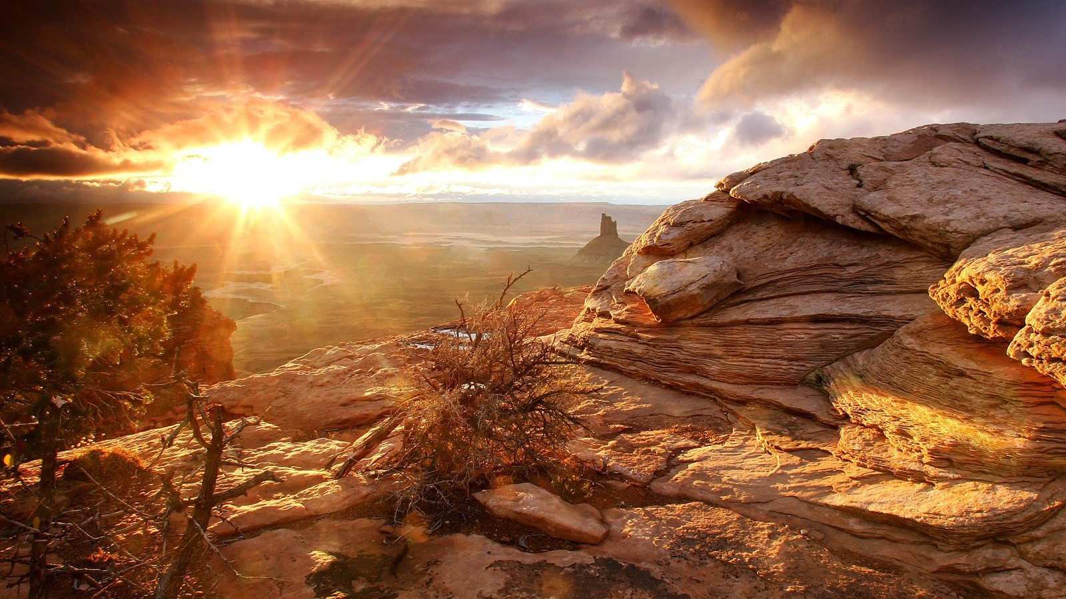
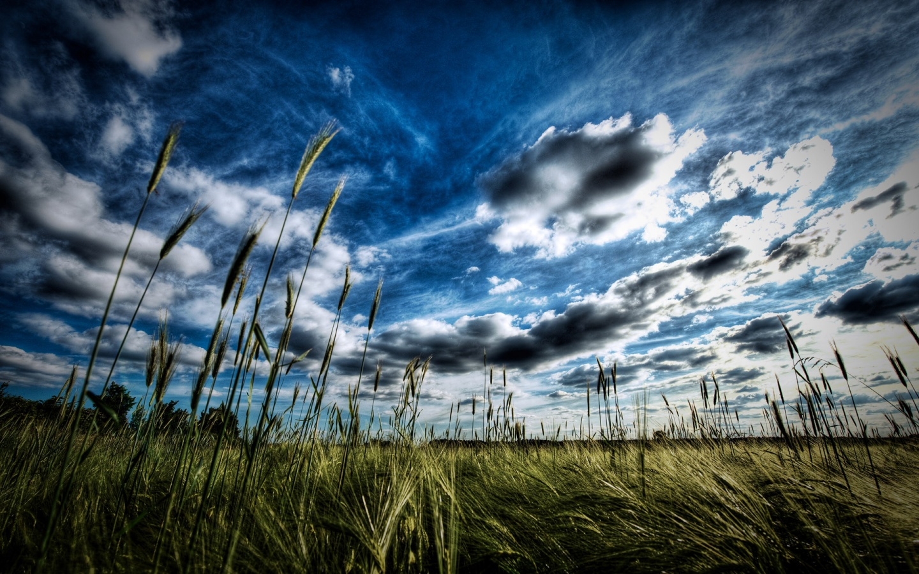
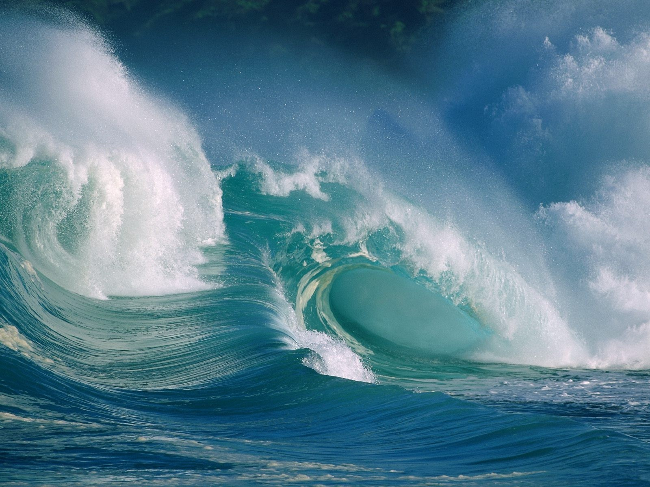
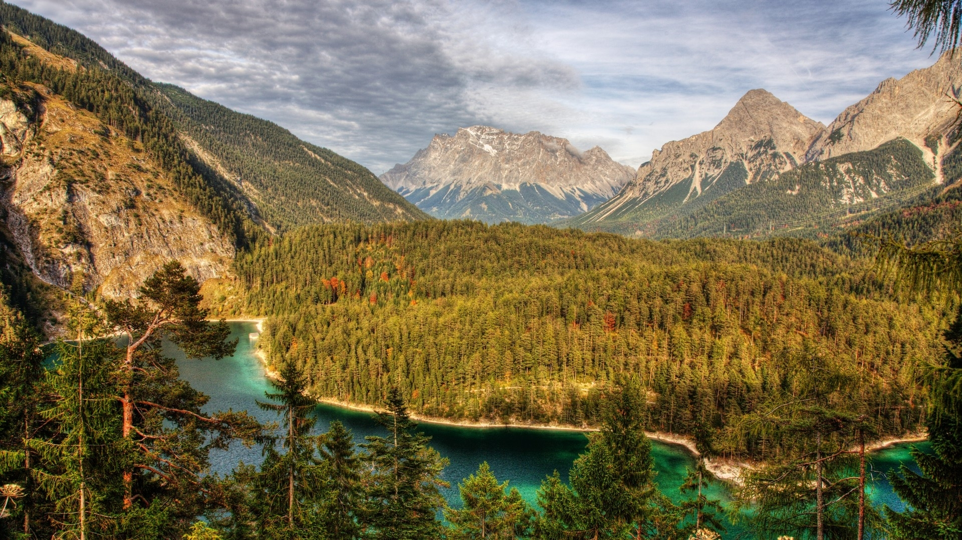
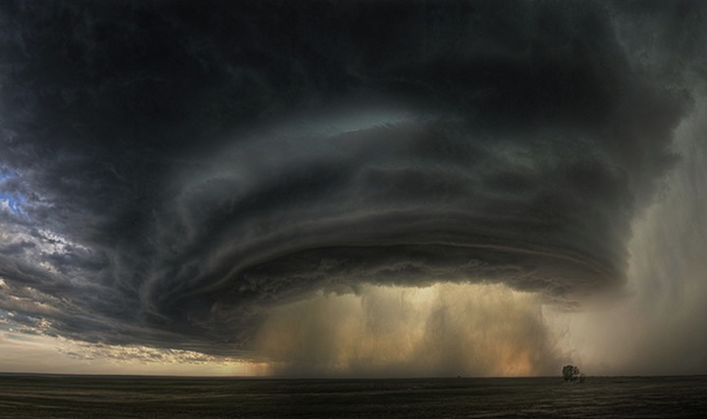
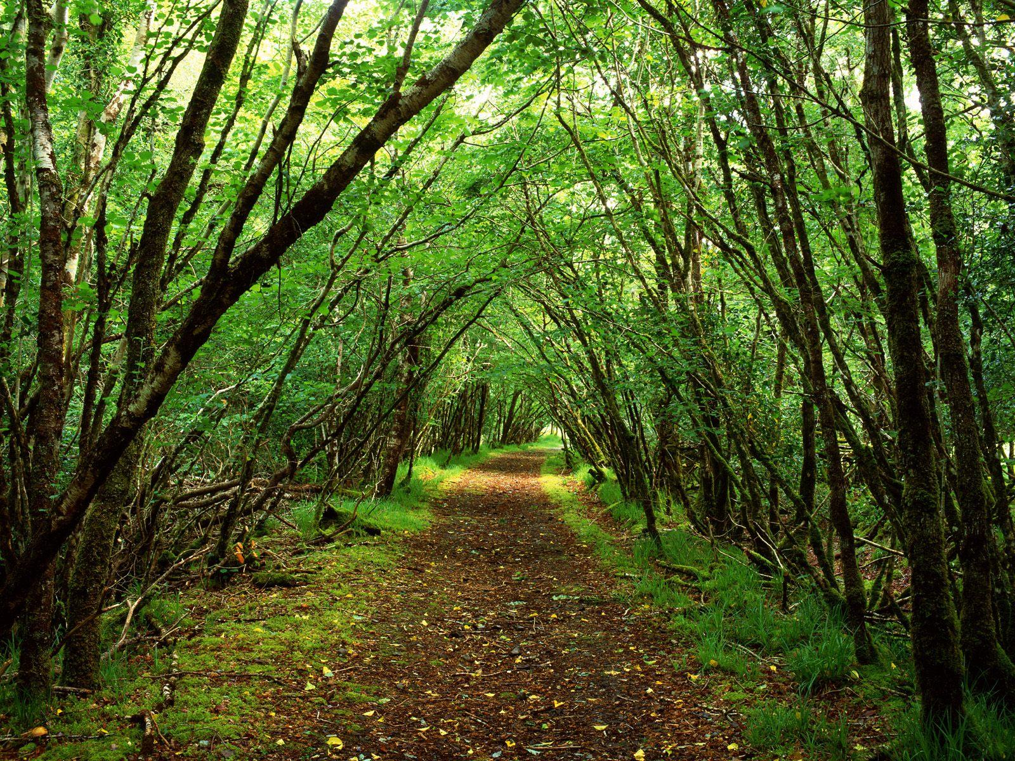
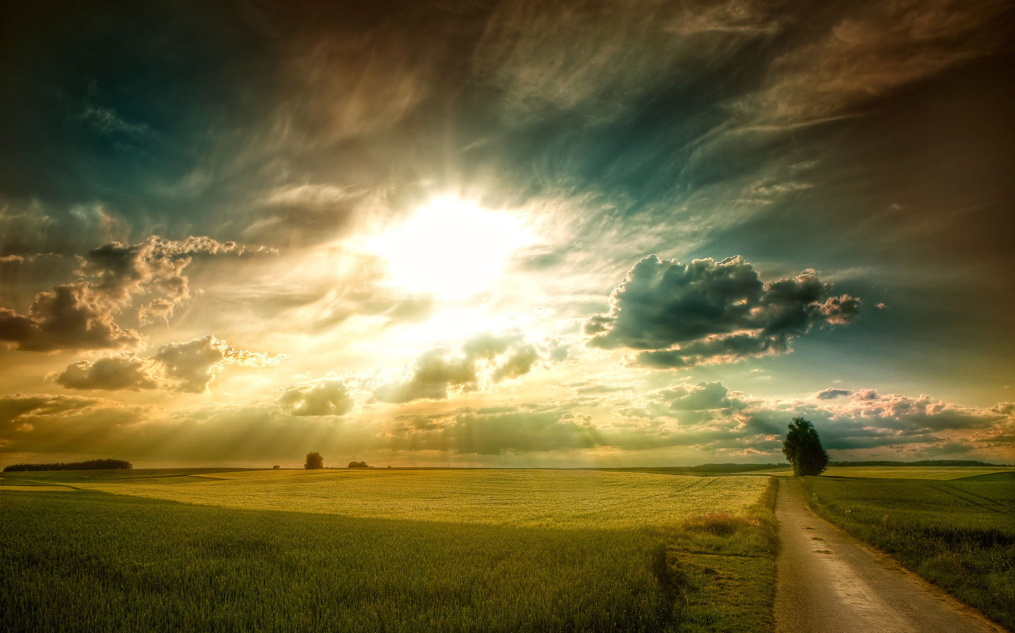
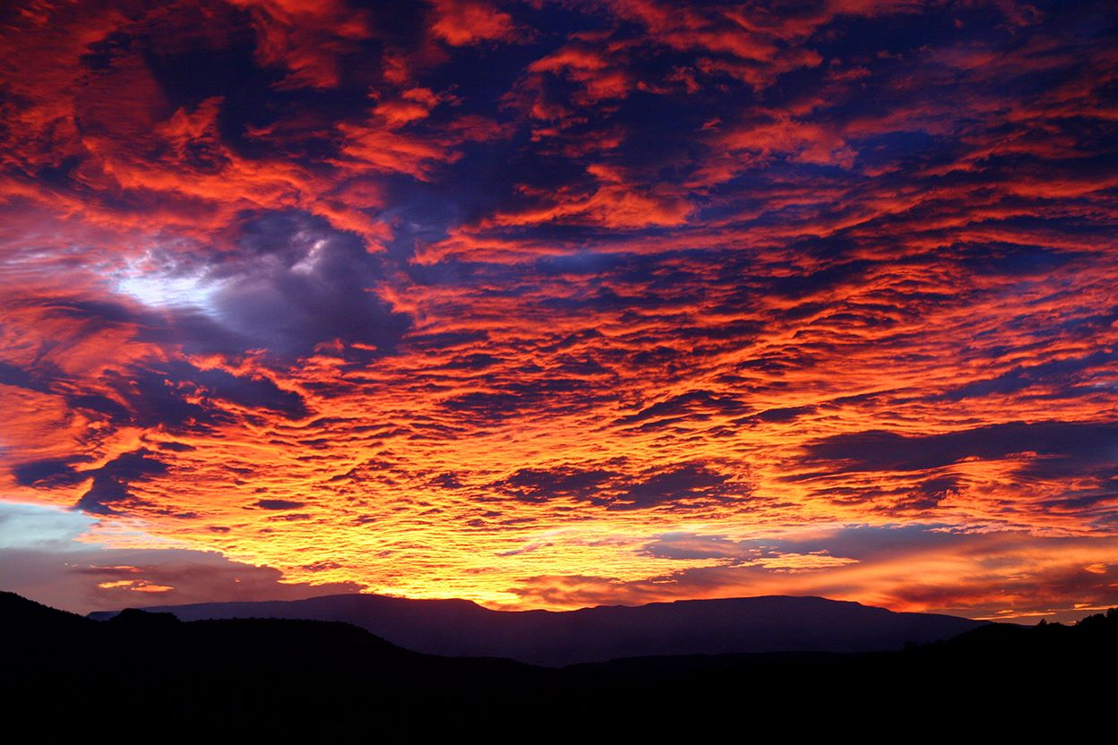
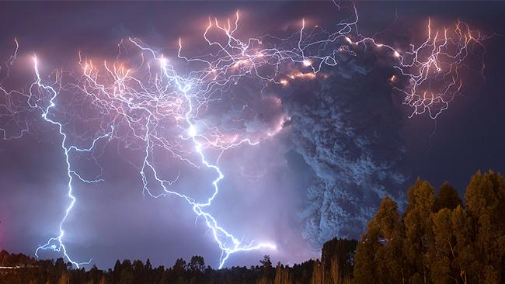
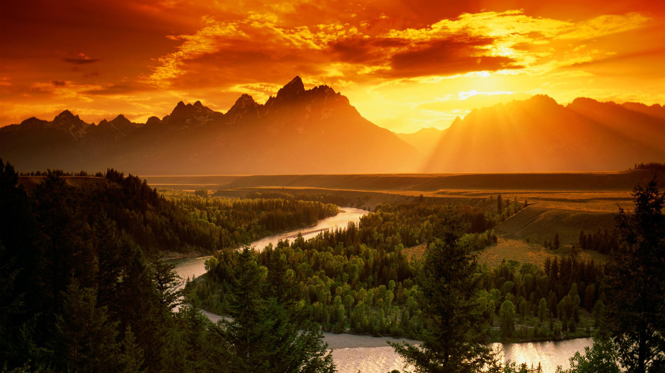
Virtual Nature Walk
For each of the following 11 pictures, write down 1-2 words describing the picture and or how it makes you feel…

Slide 8
HOMEWORK
You must spend no less than an hour. In nature.
ALONE.
No cell phone. No mp3 player. Just you.
Focus on self-reflection. Take some time to breathe deeply. To enter in with ALL of your senses. To simply BE.
When you are back at home, write a ½ page journal describing your experience and then answer these questions:
1) Was the experience easy or difficult for you?
2) Did you enjoy your time? Why or why not?
3) Was the silence bearable? Why do you think so many people are afraid of silence?
4) Did you learn anything new about yourself? What?
5) Do you think your life would look different if you did this every day?

