Slide 1
POETRY UNIT
Vocabulary, Activities,
and Lessons

Slide 2
Week 3: The Subordinating Conjunction
The subordinating conjunction joins larger groups of words within sentences. It begins adverb clauses (groups of words that answer the questions When? How? To What extent?). The subordinating conjunction can also be used to combine the ideas found in several sentences. Here are the subordinating conjunctions, followed by sample sentences.
Because Grandma was upset, she asked to be left by herself.
after | although | as | as far as | as if
as long as | as soon as | as though | because | before
even though | if | in order that | since | so that
than | though | unless | until | when
whenever | where | wherever | while
After Andy parked his new car, his sister asked for a ride.
The driver stopped her vehicle where the passengers were standing.
Our goalie, Caroline, looked as if she could block any shot.

Slide 3
Wise Words
“A poem may appear to mean very different things to different readers, and all of these meanings may be different from what the author thought he meant. For instance, the author may have been writing some peculiar personal experience, which he saw quite unrelated to anything outside; yet for the reader the poem may become the expression of a general situation, as well as of some private experience of his own. The reader's interpretation may differ from the author's and be equally valid-- it may even be better. There may be much more in a poem than the author was aware of. The different interpretations may all be partial formulations of one thing; the ambiguities may be due to the fact that the poem means more, not less, than ordinary speech can communicate.”
- T.S. Eliot

Slide 4
Wise Words
“Forgotten” by Kioni “Popcorn” Marshall, 12 years old
Notes:
Stop at 1:34

Slide 5
Class Discussion
With your shoulder partner:
Discuss your experience of poetry. Are you terrified of it? Do you like it? Do you WRITE it?
Discuss T.S. Eliot’s quote. What makes poetry SO STINKING COOL???
In your table groups:
Share your shoulder partner’s answers to the questions above.
Discuss each other’s responses as a table group.
As a class:
1. What interesting thoughts came out of your table group’s discussion about poetry?

Slide 6
Vocabulary
Poetry
A literary form that combines the precise meanings of words with their emotional associations, sounds, and rhythms.
Usually consists of the use of figurative language and sound devices
"Poetry lifts the veil from the hidden beauty of the world, and makes familiar objects be as if they were not familiar.” - Percy Bysshe Shelley
"Poetry is a speaking picture..." - Sir Philip Sidney

Slide 7
Vocabulary
Theme
Speaker
Stanza
The central message or insight into life revealed through the work. In a poem, the theme is usually found in the poem’s main “shift.”
the created narrative voice of the poem; the person the reader is supposed to imagine is talking (not necessarily the poet).
A formal division of lines in a poem. Stanzas are often separated by a line.

Slide 8
Vocabulary
Denotation
Connotation
The strict dictionary definition of a word
The emotions, thoughts and ideas associated with and evoked by a word.

Slide 9
Vocabulary
Prose
Narrative Poem
The ordinary form of written language.
Most writing that is not poetry, drama, or song is considered prose.
Established in sentence-paragraph format
Prose is one of the major genres of literature and occurs in two forms; fiction and nonfiction.
A poem that tells a story

Slide 10
VOCABULARY
The repeating of a word or words within a poetic line; used for emphasis.
The order in which rhyming words appear. This is denoted by assigning a letter to each rhyme, starting with “A”.
Row, row, row your boat (A) Gently down the stream, (B) Merrily, merrily, merrily, merrily (C) Life is but a dream (B)
This has a rhyme scheme of ABCB.
Repetition
Rhyme Scheme
-

Slide 11
VOCABULARY
End Rhyme
Internal Rhyme
Slant Rhyme
The use of rhyming words at the end of two or more lines of a poem. This is what people traditionally think of when they think of rhyming poetry.
EXAMPLE: There’s a place in France Where the naked monkeys dance.
The rhyming of words within a line of poetry, as opposed to end rhyme, which happens at the end of the lines. EXAMPLE: I awoke from a dream right into a scream.
A rhyme in which the sounds are similar but not exact, often using consonance or assonance (sometimes called near rhyme, off rhyme, imperfect rhyme). EXAMPLE: I sat in the dark/nursing my broken heart.
-

Slide 12
VOCABULARY
Alliteration
Assonance
Consonance
The repetition of consonant sounds, usually at the beginning of words. EXAMPLE: Rain running over roads.
The repetition of vowel sounds, usually within words, creating partial rhyme. It has a free and quiet element to it,
EXAMPLE: The glade, in a frail agony of grace…Time out of mind…Slap Dash…
The repetition of consonant sounds. EXAMPLE: First and last…Stroke of Luck…
-
These are the trio of sound devices that lend music and pattern to poetry.

Slide 13
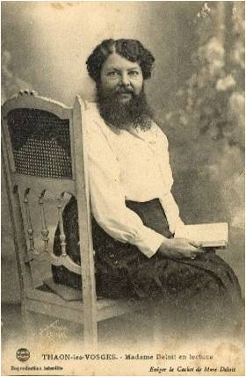
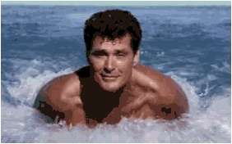
Vocabulary
Figurative Language
Simile
a word or phrase that departs from everyday literal language for the sake of comparison, emphasis, clarity, or freshness.
a figure of speech comparing two unlike things using the words “like” or “as”.
Poetry is like an onion.
Mary’s beard was as rough as sagebrush.
David Hasselhoff swims like a dolphin.

Slide 14
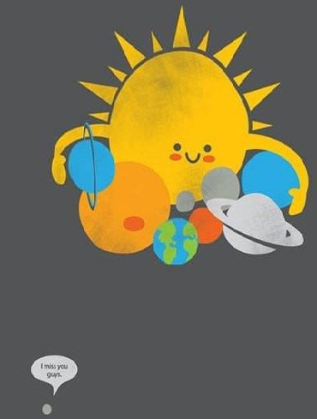
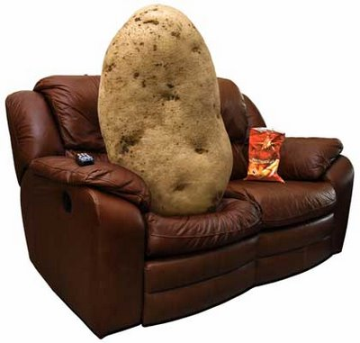
Vocabulary
A figure of speech using implied comparison of seemingly unlike things or the substitution of one for the other, suggesting some similarity. Metaphorical language makes writing more vivid, imaginative, thought provoking, and meaningful.
A figure of speech in which the author presents or describes concepts, animals, or inanimate objects by endowing them with human attributes or emotions; used to make these abstractions, animals, or objects appear more vivid to the reader.
Metaphor
Personification
She was a couch potato in the gravy boat of life, flopping dejectedly on the sofa.

Slide 15
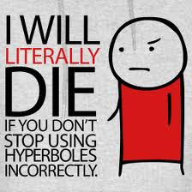
Vocabulary
A figure of speech using deliberate exaggeration or overstatement. (The literal Greek meaning is “overshoot.”)
Hyperboles often have a comic effect; however, a serious effect is also possible. Often, hyperbole produces irony.
The sensory details or figurative language used to describe, arouse emotion, or represent abstractions. On a physical level, imagery uses terms related to the five senses: visual, auditory, tactile, gustatory, and olfactory.
Hyperbole
Imagery

Slide 16
IMAGERY
The Power of Sensory Language
We will take time to gaze at each of the images on the slides that follow.
Once you have a sense of the image, in 1-2 sentences, try to capture the essence of the picture using SENSORY LANGUAGE.
Pretend I cannot see the image and use rich detail and vivid descriptions to make me feel as if I can see what you’re describing.

Slide 17
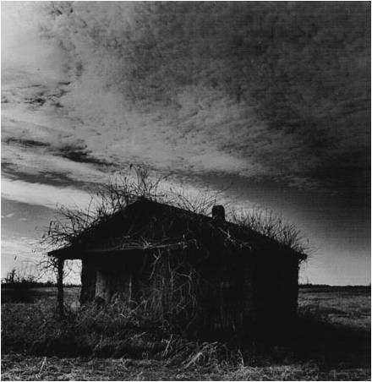

Slide 18
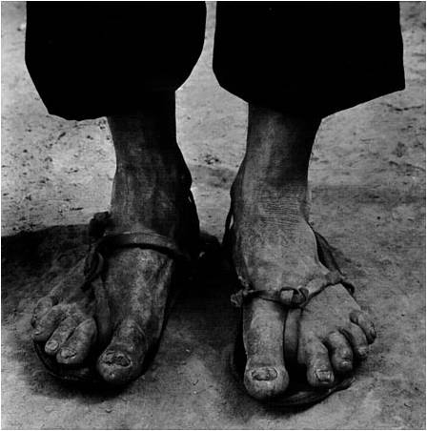

Slide 19
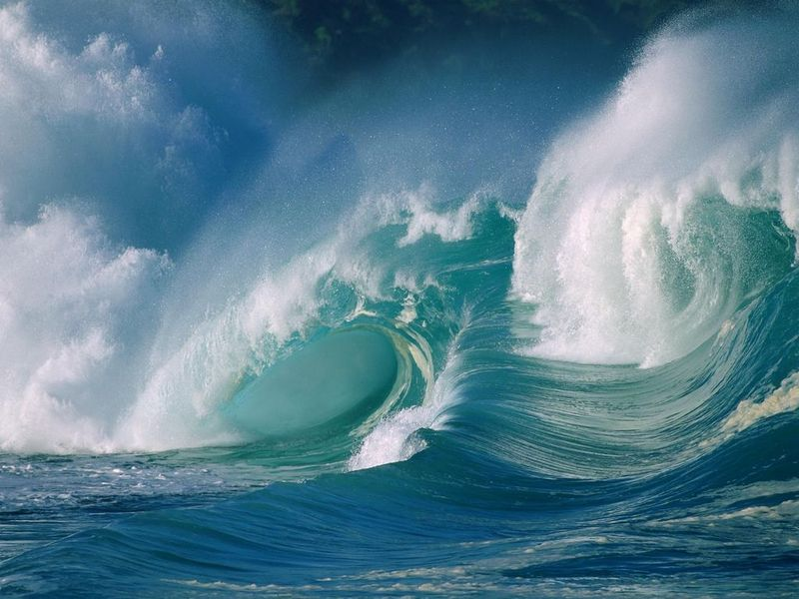

Slide 20
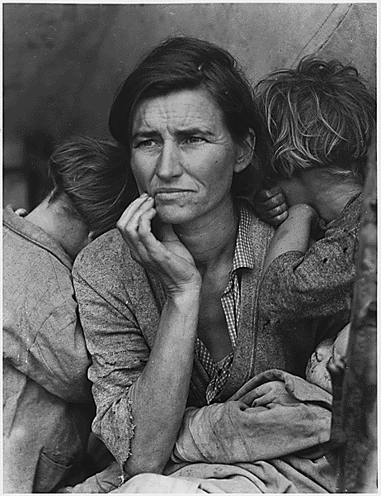

Slide 21
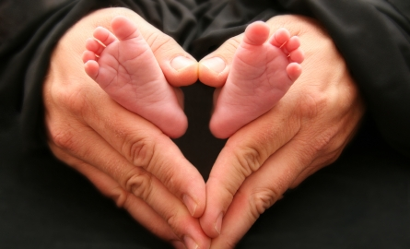

Slide 22
Vocabulary
Symbolism
A character, an action, a setting, or an object representing something else

Slide 23
Symbolism Practice
It is incredibly important to consider the qualities and associations of a symbol within a poem, while at the same time learning to differentiate between what IS and is NOT a symbol.
Take, for instance, an apple. You should be able to make associations like:
“Adam and Eve: loss of innocence or gaining of knowledge.” Or…
“Sir Isaac Newton and gravity.” Or…
“Snow White: temptation and danger.”

Slide 24
Symbolism Practice
One apple probably cannot signify all of these things, but along with the context surrounding it, you may get closer to an understanding of its symbolic value:
I took the apple from her hand And ate it, feeling almost guilty As the juice dripped down my chin.
It’s probably safe to eliminate Isaac Newton here; We seem to be pretty firmly in Eden. The next step is to examine that symbol for some of its other qualities and use them to begin to formulate an interpretation.

Slide 25
Symbolism Practice
Consider all of the symbolic possibilities for the following words:
A blind man
A dove
A river
The stars
Lightning
A mountain
Think not only about their inherent qualities, but also any cultural implications or associations.
How might each term be used symbolically in a poem? Write 1-2 possibilities for each of the words listed.

