Slide 1
To Kill a Mockingbird
Lessons, Activities, and Homework

Slide 2
May 1
2015
Do Now:
Get started on your silent reading. DictionaryLand peeps, letter “E”.
Period 5: Turn in your level questions and answers for Ch.7-9
Reminders: Prepare for quizzes! They’ll be the easiest way to raise your grade!
Agenda:
Silent reading
Quiz Ch.10-11
Working with Ch.10-11
Analyzing Part 1 for theme
Last Class:
Ch. 7-9
Next Class:
Discussing Part One of the novel
Homework: Finish the work from the PowerPoint and prepare for analysis of Part I
Our Learning Focus for Today:
Analyze how an author uses multiple literary elements in one passage to develop a theme.
Write an interpretive statement about the significance of literary elements.
Gather textual evidence to generate theme statements.
• Respond to an analytical writing prompt..

Slide 3
Chapter 10: It’s a Sin to Kill a Mockingbird…
When he gave us our air rifles Atticus wouldn’t teach us to shoot. Uncle Jack instructed us in the rudiments thereof; he said Atticus wasn’t interested in guns. Atticus said to Jem one day, “I’d rather you shot at tin cans in the back yard, but I know you’ll go after birds. Shoot all the bluejays you want, if you can hit ‘em, but remember it’s a sin to kill a mockingbird.”
That was the only time I ever heard Atticus say it was a sin to do something, and I asked Miss Maudie about it.
“Your father’s right,” she said. “Mockingbirds don’t do one thing but make music for us to enjoy. They don’t eat up people’s gardens, don’t nest in corncribs, they don’t do one thing but sing their hearts out for us. That’s why it’s a sin to kill a mockingbird.” p.90
Based on your understanding of Atticus’s character, why do you think he isn’t interested in guns?
How does Miss Maudie’s information about mockingbirds add to Atticus’s comment that “it’s a sin to kill a mockingbird”?
Based on this passage, what might a mockingbird symbolize?

Slide 4
Chapter 11: Mrs. Dubose & Life Lessons
Consider the significance of character, conflict, and setting in the passage about Mrs. Dubose Use the following sentence stems to generate an interpretive statement about each of these elements.
The character of Mrs. Dubose represents . . .
The conflict between the children and Mrs. Dubose is similar to . . .
The setting of Mrs. Dubose’s house, halfway between the Finch home and the town, is significant because . . .
In the following quotation, Atticus gives Jem advice on how to deal with Mrs. Dubose. Consider how this advice might foreshadow the way Atticus wants the children to act during the trial. “You just hold your head high and be a gentleman. Whatever she says to you, it’s your job not to let her make you mad.” Rewrite Atticus’s advice as a statement or “life lesson.”
Work with your table group to find at least three more quotes/examples of Atticus’s “life lessons” from other chapters. Rewrite them as you did above.

Slide 5
Themes in To Kill a Mockingbird
We will now use the quotes to identify themes based on the lessons Atticus wants his children to learn as they come of age. Create a web of these and other themes Harper Lee explores in Part One of To Kill a Mockingbird.
When identifying themes, keep in mind the following:
A theme is a message, not just a topic, and it cannot be just a word, such as prejudice. A theme from To Kill a Mockingbird would be “Prejudice is based on fear.”
Avoid clichés such as “Blood is thicker than water.”
Don’t state a theme as an order: “People must not be racist.”
Themes should be universal.

Slide 6
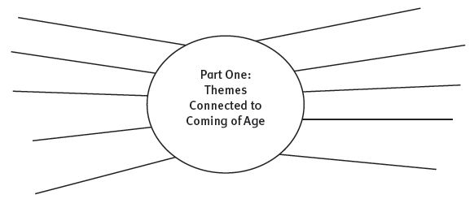
Themes in To Kill a Mockingbird

Slide 7
Review & Analysis of Part 1
SETTING | CONFLICT | CHARACTER
List various IMPORTANT settings within the novel so far and explain what significance/symbolism they hold in the novel. | List significant conflicts that the characters in the novel have experienced so far and make predictions about how they might affect the plot further on in the story. | Identify the main characters in the novel and give a brief description of them along with the significance of their character in the novel.
You must have a minimum of three examples under each column and MUST include textual evidence to support your reasoning.

Slide 8
One Pager
Analyze how character, conflict, or setting contribute to a “coming of age” theme in Part 1 of the novel. Be sure to:
Begin with a topic sentence that connects your chosen literary element to a theme.
Include textual evidence in the form of direct quotations.
Provide commentary explaining how your quotes support your analysis

