Slide 1
TRANSCENDENTALISM
“It was a high counsel that I once heard given to a young person…always do that which you are afraid to do.” Ralph Waldo Emerson, father of Transcendentalism

Slide 2
Agenda Day 5: 2/3 & 2/4
Bellwork: SSR Log (Monday) or Grammar (Tuesday)
Walden Tweets table discussion
Class Discussion about “Simplifying” Challenge
Read “Self-Reliance” by Emerson as a class
Transcendentalism in Music
Annotate “Self-Reliance” and do SOAPStone and rhetorical precis independently
HOMEWORK: Finish your rhetorical precis at home for “Self-Reliance” and bring in your own Transcendental song (highlight the “transcendental” lines and write a ½ page paragraph explaining why you think this song could be considered Transcendental.

Slide 3
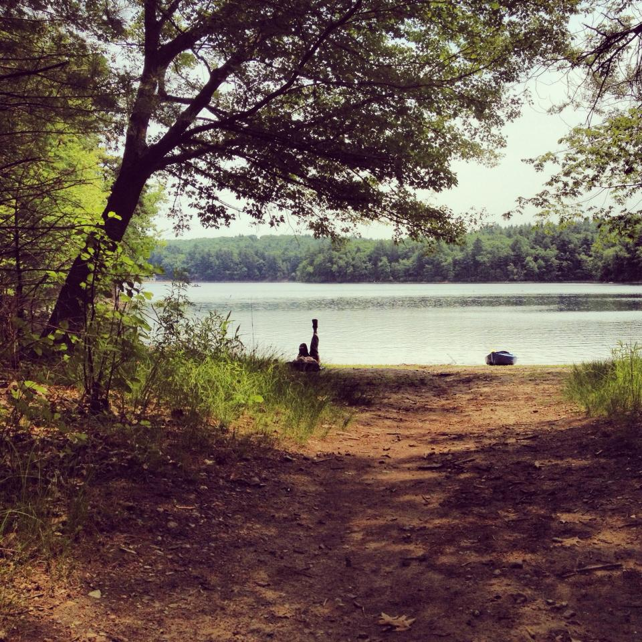
Walden Tweets Table Discussion
Share your 10 tweets in your table groups and pick the BEST tweet to share with the class.
You only have 3 minutes!!!

Slide 4
“Simplify. Simplify. Simplify.”
Answer the following questions on the back of your “Walden Tweets” paper. You have 5 minutes to write down your answers. Be ready to discuss as a class.
What did you choose to do to simplify your life this weekend? Why did you pick that?
What obstacles did you come up against when attempting to live out the challenge?
Is living simply a way of life you think you could embrace? Why or why not?
What did you learn about yourself through this?

Slide 5
“Walden”: 1st Read-Through (Class)
As a class, please take turns reading through “Self-Reliance,” paragraph by paragraph.
After each paragraph, stop and summarize it as a table group, then write down the summary for each paragraph on your own sheet of paper. Please make sure you number each of your paragraphs (there should be 5)!
Your paragraph summaries will be collected today during class.

Slide 6
Transcendentalism in Music
We will now examine Transcendental elements present in music. You may or may not be familiar with the songs or artists that we will play, but in truth, you can look through your own personal stash of music and find a handful of songs that might be considered “Transcendental.”
As you listen to these songs, follow along on your own paper. When each song is finished, highlight the lines/lyrics which you think have transcendental elements (nature, individuality, self-reliance, intuition, simplicity, anti-materialism, living life to the fullest, etc) and explain why in the margins. We will have a short discussion after each song to come to a consensus as to which lyrics are transcendental.

Slide 7
“The Cave”- Mumford & Sons
It's empty in the valley of your heart The sun, it rises slowly as you walk Away from all the fears And all the faults you've left behind
The harvest left no food for you to eat You cannibal, you meat-eater, you see But I have seen the same I know the shame in your defeat
But I will hold on hope And I won't let you choke On the noose around your neck
And I'll find strength in pain And I will change my ways I'll know my name as it's called again
‘Cause I have other things to fill my time You take what is yours and I'll take mine Now let me at the truth Which will refresh my broken mind
So tie me to a post and block my ears I can see widows and orphans through my tears I know my call despite my faults And despite my growing fears
CHORUS
So come out of your cave walking on your hands And see the world hanging upside down You can understand dependence When you know the maker's land
So make your siren's call And sing all you want I will not hear what you have to say
‘Cause I need freedom now And I need to know how To live my life as it's meant to be
CHORUS

Slide 8
“Ants Marching”- Dave Matthews Band
He wakes up in the morning
Does his teeth bite to eat and he's rolling
Never changes a thing
The week ends the week begins
She thinks, we look at each other
Wondering what the other is thinking
But we never say a thing
These crimes between us grow deeper
Take these chances
Place them in a box until a quieter time
Lights down, you up and die
Goes to visit his mommy
She feeds him well his concerns
He forgets them
And remembers being small
Playing under the table and dreaming
CHORUS
Driving in on this highway
All these cars and upon the sidewalk
People in every direction
No words exchanged
No time to exchange
And all the little ants are marching
Red and black antennas waving
They all do it the same
They all do it the same way
Candyman tempting the thoughts of a
Sweet tooth tortured by the weight loss
Program cutting the corners
Loose end, loose end, cut, cut
On the fence, could not to offend
Cut, cut, cut, cut
CHORUS

Slide 9
“Gone, Going”- Black Eyed Peas & Jack Johnson
Johnny wanna be a big star Get on stage and play the guitar Make a little money, buy a fancy car Big old house and an alligator Just to match with them alligator shoes He's a rich man so he's no longer singing the blues He's singing songs about material things And platinum rings and watches that go bling But, diamonds don't bling in the dark He a star now, but he ain't singing from the heart Sooner or later he's just gonna fall apart Cause his fans can't relate to his new found art He ain't doing what he did from the start And that's putting in some feeling and thought He decided to live his life shallow Cash in his love for material, and it’s gone. Gone, going. Gone, everything gone, give a damn. Gone be the birds when they don't want to sing. Gone people, all awkward with their things... Gone.
You see yourself in the mirror And you feel safe cause it looks familiar But you afraid to open up your soul Cause you don't really know, don't really know Who he is, the person that's deep within Cause you are content with just being the name-brand man And you fail to see that its trivial Insignificant, you addicted to material I've seen your kind before You're the type that thinks souls is sold in a store Packaged up with incense sticks With them vegetarian meals To you that's righteous You're fiction like books You need to go out to life and look Cause... what happens when they take your material You already sold your soul and its...
CHORUS You say that time is money and money is time So you got mind in your money and your money on your mind But what about... that crime that you did to get paid And what about... that bid, you can't take it to your brain What about those shoes you'll wear today They'll do no good on the bridges you burnt along the way All that money that you got…gonna be gone That gear that you rock…gonna be gone The house up on the hill…gonna be gone The gold purse on your grill…gonna be gone The ice on your wrist…gonna be gone That nice little Miss…gonna be gone That whip that you roll…gonna be gone And what's worst is your soul's already gone
CHORUS

Slide 10
“I Don’t Want To Be”- Gavin DeGraw
I don't need to be anything other Than a prison guard's son I don't need to be anything other Than a specialist's son I don't have to be anyone other Than the birth of two souls in one Part of where I'm going, is knowing where I'm coming from I don't want to be Anything other than what I've been trying to be lately All I have to do Is think of me and I have peace of mind I'm tired of looking 'round rooms
Wondering what I've got to do Or who I'm supposed to be I don't want to be anything other than me
I'm surrounded by liars everywhere I turn I'm surrounded by imposters everywhere I turn I'm surrounded by identity crisis everywhere I turn Am I the only one who noticed? I can't be the only one who's learned! CHORUS Can I have everyone's attention please? If you're not like this and that, you're gonna have to leave I came from the mountain The crust of creation My whole situation-made from clay to stone And now I'm telling everybody CHORUS I don't want to be [x4]

Slide 11
“Self-Reliance”: 2nd Read-Through
You will now, INDEPENDENTLY, highlight, annotate, label, and explain as you’ve been taught to do (don’t just highlight!!! You MUST have margin notes!).
Here’s a reminder:
Highlight the main idea(s) in green.
Highlight all supporting details in yellow.
Highlight any examples of rhetoric (persuasive appeals, tone, diction, syntax, allusion, etc) in pink.
Circle difficult/unknown words and define them.
Your margin notes should label and/or explain.

Slide 12
SOAPStone- Self-Reliance
Please copy down the table below on your own piece of paper. You have 10 minutes to fill it out on your own. This will be collected at the end of the 10 minutes.
 | What’s the answer? | Textual evidence?
Subject
Occasion
Audience
Position
Speaker
Tone

Slide 13
HOMEWORK
Write up a rhetorical precis for “Self-Reliance” (use your notes from last class)
Bring in your own printed copy of a song that could be considered “transcendental.” Please make sure you highlight the lyrics that are transcendental in nature with an explanation in the margins as to WHY. Then, write a ½ page paragraph explaining why this song could be considered “Transcendental.”

