Slide 1
TRANSCENDENTALISM
“It was a high counsel that I once heard given to a young person…always do that which you are afraid to do.” Ralph Waldo Emerson, father of Transcendentalism

Slide 2
Agenda Day 6: 2/5 & 2/6
Bellwork- Grammar (Wednesday) or Journal (Thursday)
Collect Bellwork Packet #2 (Thursday only)
Collect “Self-Reliance” rhetorical precis & song
Transcendental Music discussion
Four Corners
Civil Disobedience
HOMEWORK: Civil Disobedience questions, Socratic Seminar questions, and start a movement. ☺

Slide 3
Transcendental Music Assignment
Share the song that you brought in with your table group and explain why you think that was a good choice for a “transcendental” song.
Was anyone surprised by how many songs they discovered that actually have transcendental characteristics or themes?
You will never hear music the same way again.
You’re welcome. ☺

Slide 4
Four Corners Activity
For each of the following statements, decide whether you Strongly Agree, Agree, Disagree, or Strongly Disagree, and then move to that designated corner of the room. Be ready to defend your answer and do not speak until you’ve been called on.
All people in America have equal rights.
Every person in America, legal or not, deserves citizen privileges (voting, own land, education, medical care, etc.).
Men and women are equal.
A person’s race/gender does not impact their opportunities in America.
I would break the law for a greater cause, even if it meant getting punished.
There are certain beliefs the government SHOULD try to control.
We should be forced to pay taxes to support those less fortunate.
People who break the law, even for a valid reason, should be punished.

Slide 5
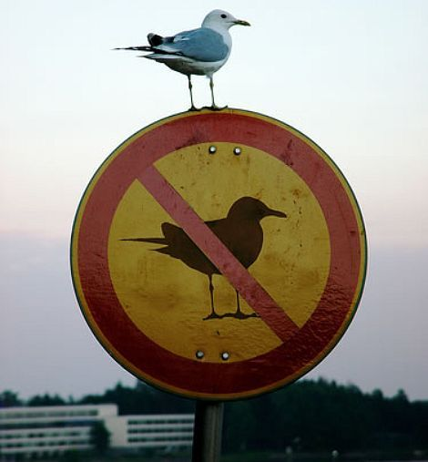
Civil Disobedience
“The refusal to obey certain laws or governmental demands for the purpose of influencing legislation or governmental policy, characterized by the employment of such non-violent techniques as boycotting, picketing, and non-payment of public taxes.”
Please take Cornell notes on the following Prezi presentation:
Civil Disobedience
On the next slide, reflect on the images and the courage it requires to take a stand.

Slide 6
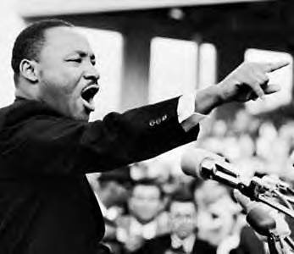
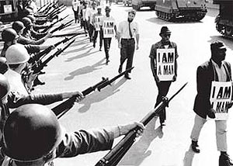
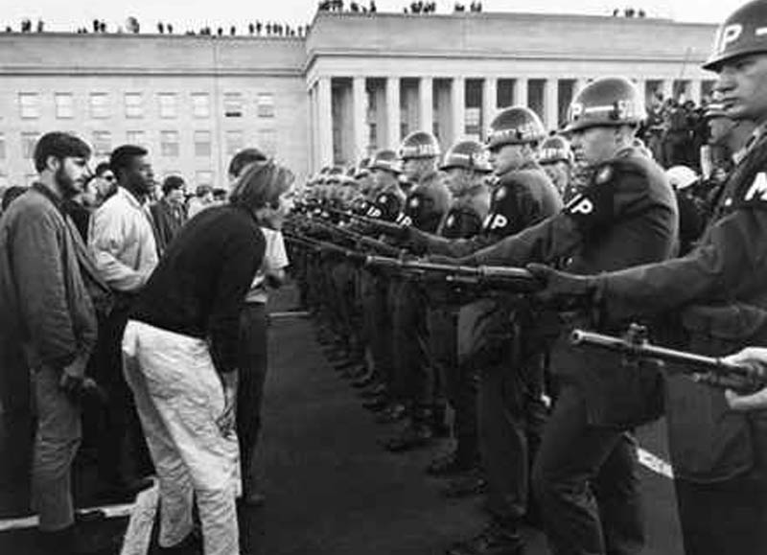
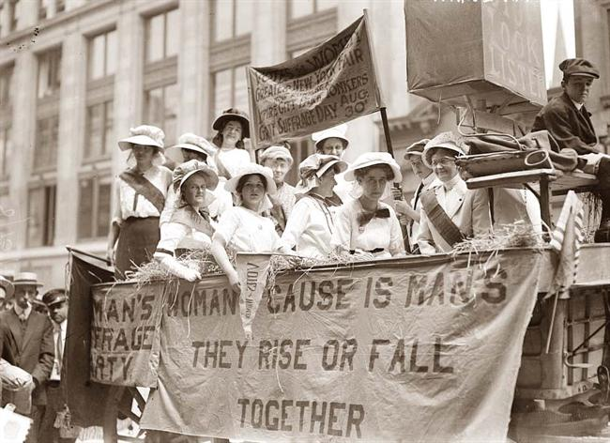
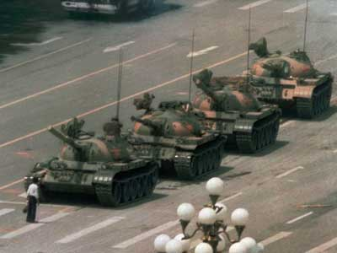
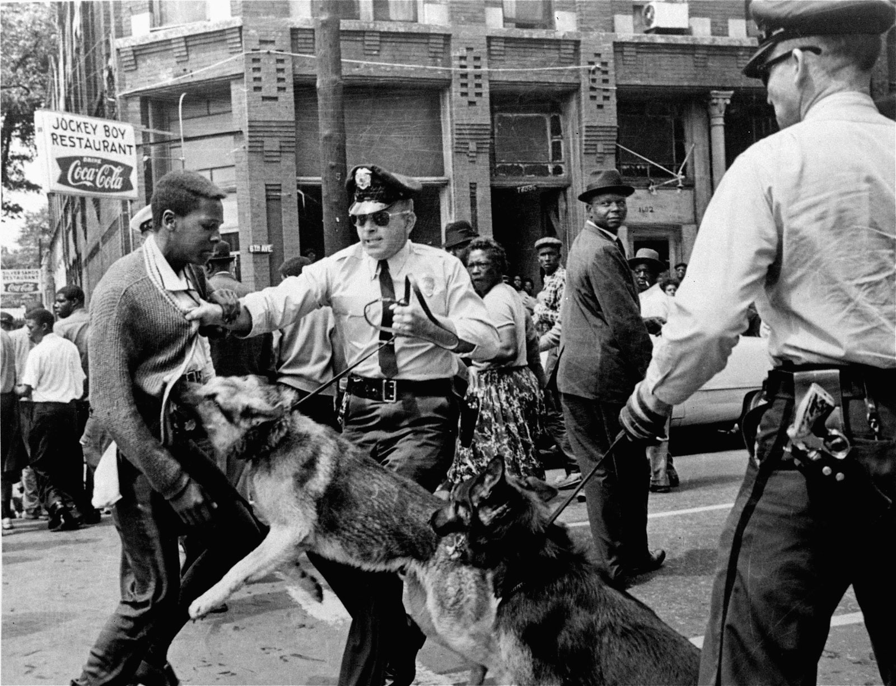
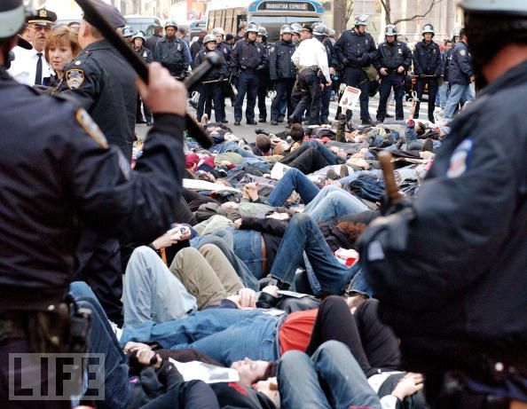
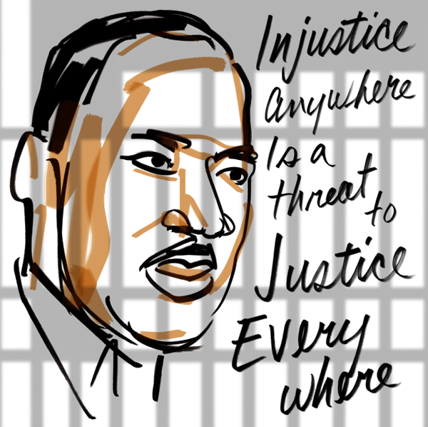
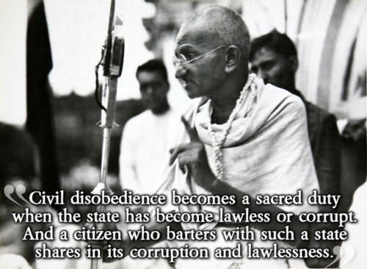
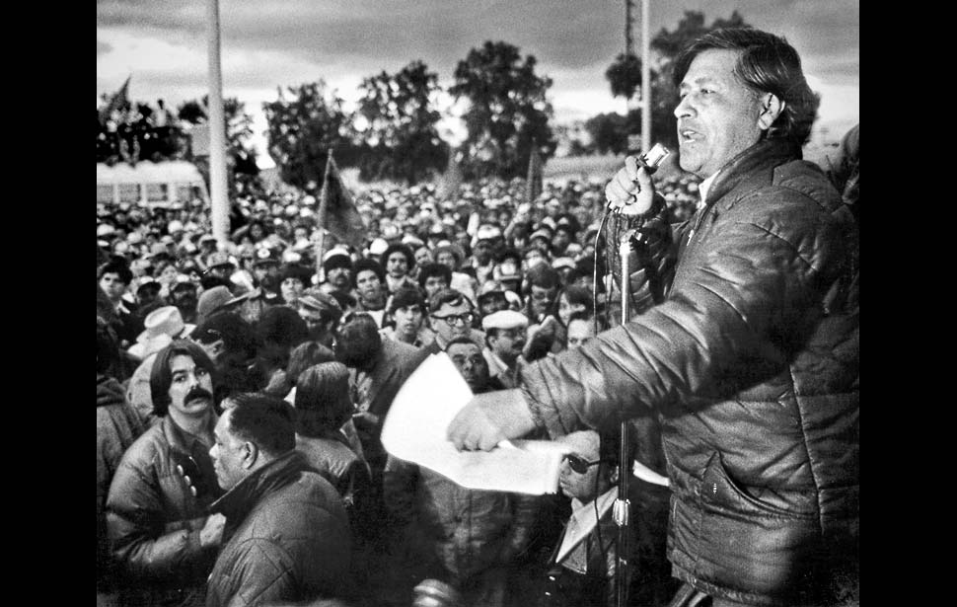
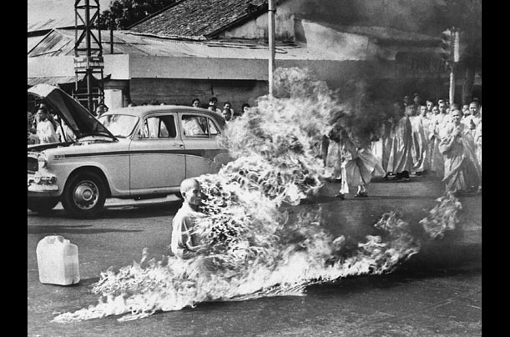
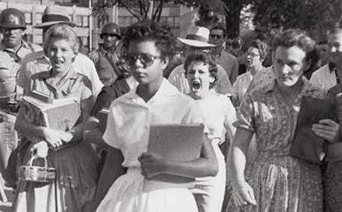
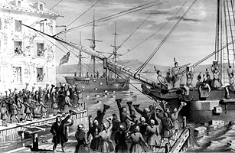

Slide 7
“Civil Disobedience”: 1st Read-Through (Class)
As a class, please take turns reading through “Self-Reliance,” paragraph by paragraph.
After we finish, stop and summarize each paragraph as a table group, then write down the summary for each paragraph on your own sheet of paper. Please make sure you number each of your paragraphs!
Your paragraph summaries will be collected today during class.

Slide 8
“Civil Disobedience”: 2nd Read-Through
You will now, INDEPENDENTLY, highlight, annotate, label, and explain as you’ve been taught to do (don’t just highlight!!! You MUST have margin notes!).
Here’s a reminder:
Highlight the main idea(s) in green.
Highlight all supporting details in yellow.
Highlight any examples of rhetoric (persuasive appeals, tone, diction, syntax, allusion, etc) in pink.
Circle difficult/unknown words and define them.
Your margin notes should label and/or explain.

Slide 9
“Civil Disobedience”: Questions
When you’ve finished annotating, please get started on the handout with the questions pertaining to “Civil Disobedience.”
You must answer each question thoroughly, using complete sentences. Some questions have more than one part. Work quietly and on your own during this time.

Slide 10
How to Start a Movement
If you could start whatever movement you wanted to, whether through an act of civil disobedience or not, what would it be and why?
Do you think you have the power to change the world? Why or why not?
Watch this video before we discuss your homework:
How to Start a Movement

Slide 11
Homework
Finish answering the questions on the “Civil Disobedience” handout.
Try to start a “movement” or trend on Facebook, Twitter, or Instagram and see how many people you can get to jump on board within 24 hours. If you don’t have a social media account, then start a written petition and get signatures! Make it about something relatively serious. The person with the most “followers” will receive a prize. ☺
SOCRATIC SEMINAR ASSESSMENT NEXT CLASS! I hope you’ve been annotating your little heart out as best you can, because we’re having a Socratic Seminar next class. To prepare, please review all four texts, along with all notes that you took. You MUST prepare 2 open-ended, seminar-style questions for each of the texts we read (8 total questions), plus an additional 5 questions related to Transcendentalism in general.

